Slide 1
Standards Wars
May 21st & 26th, 2008
Digital Economics
Byung Joon Yoo

Slide 2
Examples
RR gauges(4’81/2” vs. 5’)
Edison v. Westinghouse (Direct Current vs. Alternating Current)
NBC v. CBS in color TV
3Com v. Rockwell/Lucent (56k Modem)

Slide 3
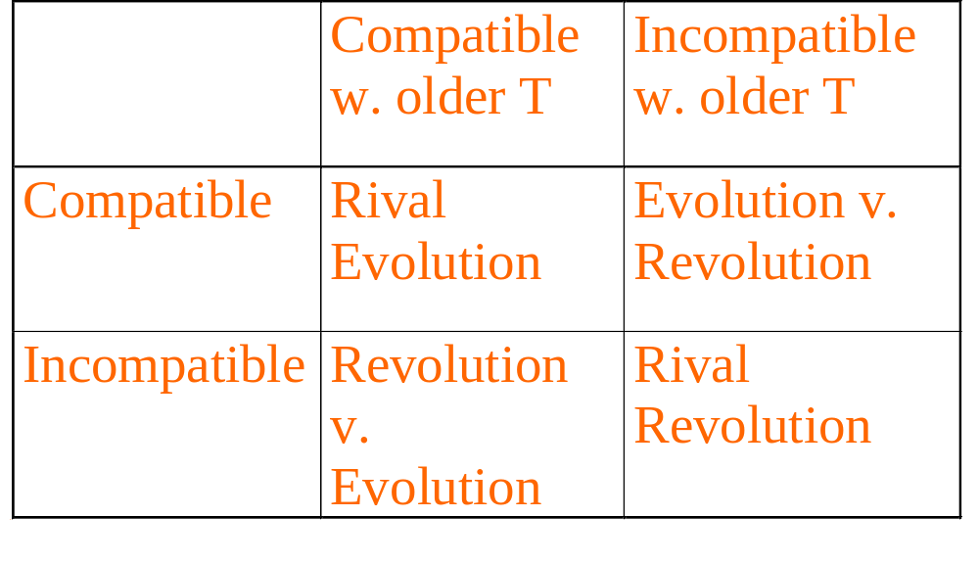
Classification of Wars

Slide 4
Examples
Rival evolution
  DVD vs. Divx (CD), 56k modem (w. 28k)
Rival revolutions
  Video players, AC vs. DC, High density disks (JAZ, etc.)
Evolution v. Revolution
  Lotus 1-2-3 vs. Excel
  dBase IV vs. Paradox

Slide 5
Recent Standards Wars
AM stereo (Mutually destructive)
  Auto industry (GM) invested, radio didn’t
  5 Players, Failure with uncertainty and insufficient network effect
Digital wireless phones (Incompatible still)
  Europe: GSM (Global system for mobile comm)
  US: GSM, TDMA (cousin of GSM), CDMA
    TDMA: 5 million
    CDMA: 2.5 million
    GSM: 1 million in 1997 (vs. 50 million analog)

Slide 6
Standards Wars
Ericsson (TDMA) has AT&T, SBC , Bellsouth
Qualcom (CDMA) has Bell Atlantic, US West, Airtouch, Nynex
  Performance play strategy
How big are the network externalities?
  Geographic scope – Local, Long distance different
  Not much because: Investment is sunk, systems interconnected
  Only Lock-in is the handheld device <- Subsidy
  Not winner-take-all market
  Decentralized, market-oriented approach (US) slower but more chances to small players

Slide 7
Standards Wars, cont’d.
56K modems
  US Robotics (3com) x2 attempted preemption over 28.8k(V.34 ITU standard)
  Rockwell/Lucent K56 Flex
  Expectations management, switching costs
  Problems in 97: x2 for ISP, Rockwell for household (No benefit of 56k!)
  Settled Dec 97 (ITU V.90): estimated will triple size of market (Win-Win 10M->33M in 1998)

Slide 8
Key Assets
Control over an installed base (MS)
Intellectual property rights (patent, copyrights)
Ability to innovate (HP engineering skills easy to catch up)
First-mover advantages
Manufacturing (Scale economics – Dell)
Strength in complements (Additional benefit)
Reputation and brand name (Consumers also)
->Make firms to win at war or to be at more advantageous position in setting standard

Slide 9
Two Basic Tactics
Preemption
  Build installed base early (+penetration pricing)
  But watch out for rapid technological progress (Japan HDTV vs. US HDTV)
  (zero price possible, but negative not easy because of fraud)
Expectations management
  Manage expectations
  But watch out for vaporware (MS: Windows98 delay)
  The Best: Advertise Alliances (Sun)

Slide 10
Once You’ve Won
Stay on guard
  French Minitel before Internet
Offer a migration path
  Ashton-Tate to Borland’s Paradox
  MS ‘embrace and extend’
Commoditize complementary products
  Intel – Encourage complementors (Failure: Apple – Corbis)
Competing against your own installed base
  Durable goods monopoly, Intel again – Speed (effect like renting durables)

Slide 11
Once You’ve Won, cont’d.
Attract important complementors (maintain monopoly for them w. good deals-legal concerns)
Leverage installed base (strengths)
  Expand to adjacent product space w. base
  Expand network geographically
Stay a leader
  Know how tech will evolve (Informational advantage)
  Develop proprietary extensions
  Allow the development of standard on your term (access fee or licensing fee as a bottom line)

Slide 12
What if You Fall Behind?
Survive one round with small share (niche)
Adapters and interconnection (If possible legally)
  Wordperfect – Two way compatibility with MS Word
  Borland v. Lotus – Huge law suit
  Translators, etc (Problem: How much compatible)
Survival pricing (cut price to spur sale)
  Hard to pull off, Bad, Not working for business
  Different from penetration pricing (good)
Legal approaches
  Sun v. Microsoft

Slide 13
Microsoft v. Netscape
Rival evolutions
Low switching costs
Small network externalites (simple)
Strategies
  Preemption-Acquire first
  Penetration pricing-Regal vs. Special
  Expectations management - Partners, vision
  Alliances – Netscape w.Sun, MS w.S techmall browser

Slide 14
Lessons
Understand the type of war
  Rival evolution
  Rival revolution
  Revolution v Evolution
Strength depends on 7 critical assets
Preemption is a critical tactic
Expectations management is critical

Slide 15
Lessons, continued
When you’ve won the war, don’t rest easy
If you fall behind, avoid survival pricing

Slide 16
Next Week
IR: Ch.10 Information Policy
Just two weeks left for Final Term Paper

